Slide 2
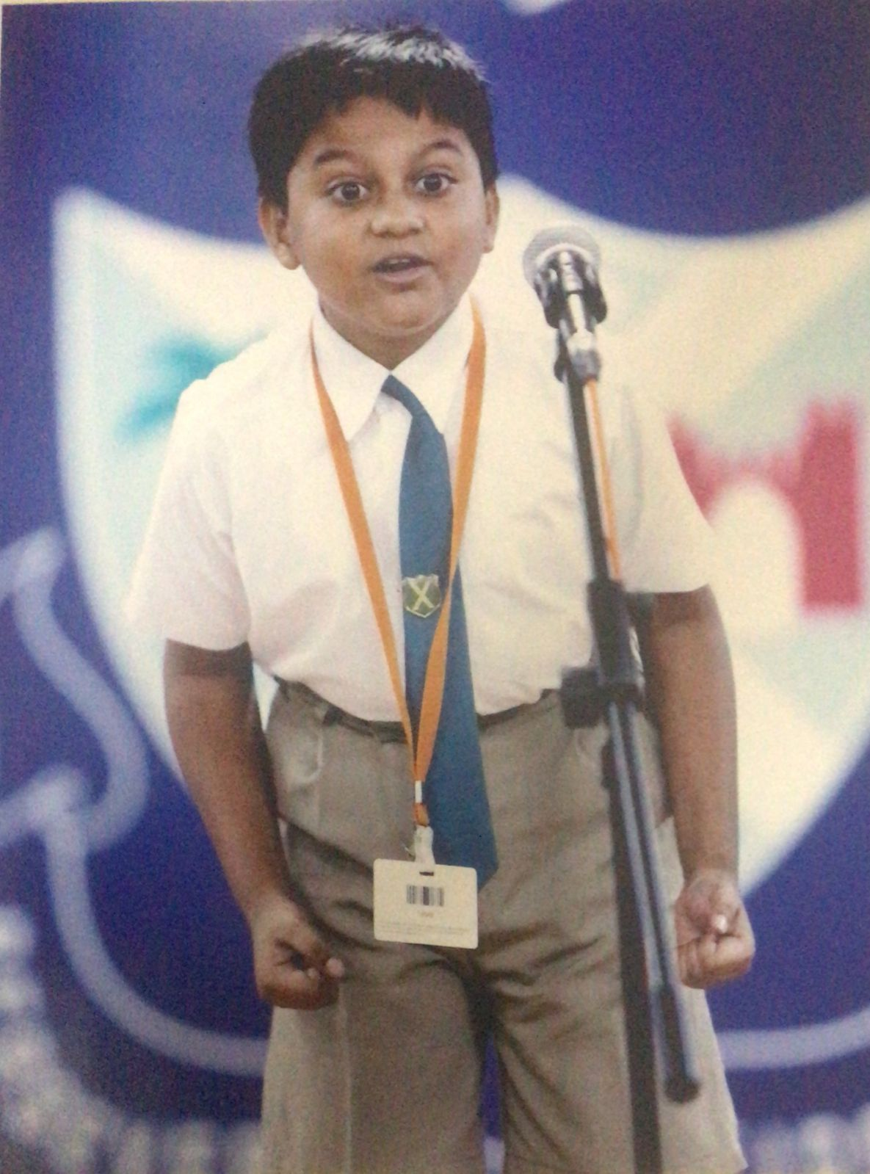

Slide 3
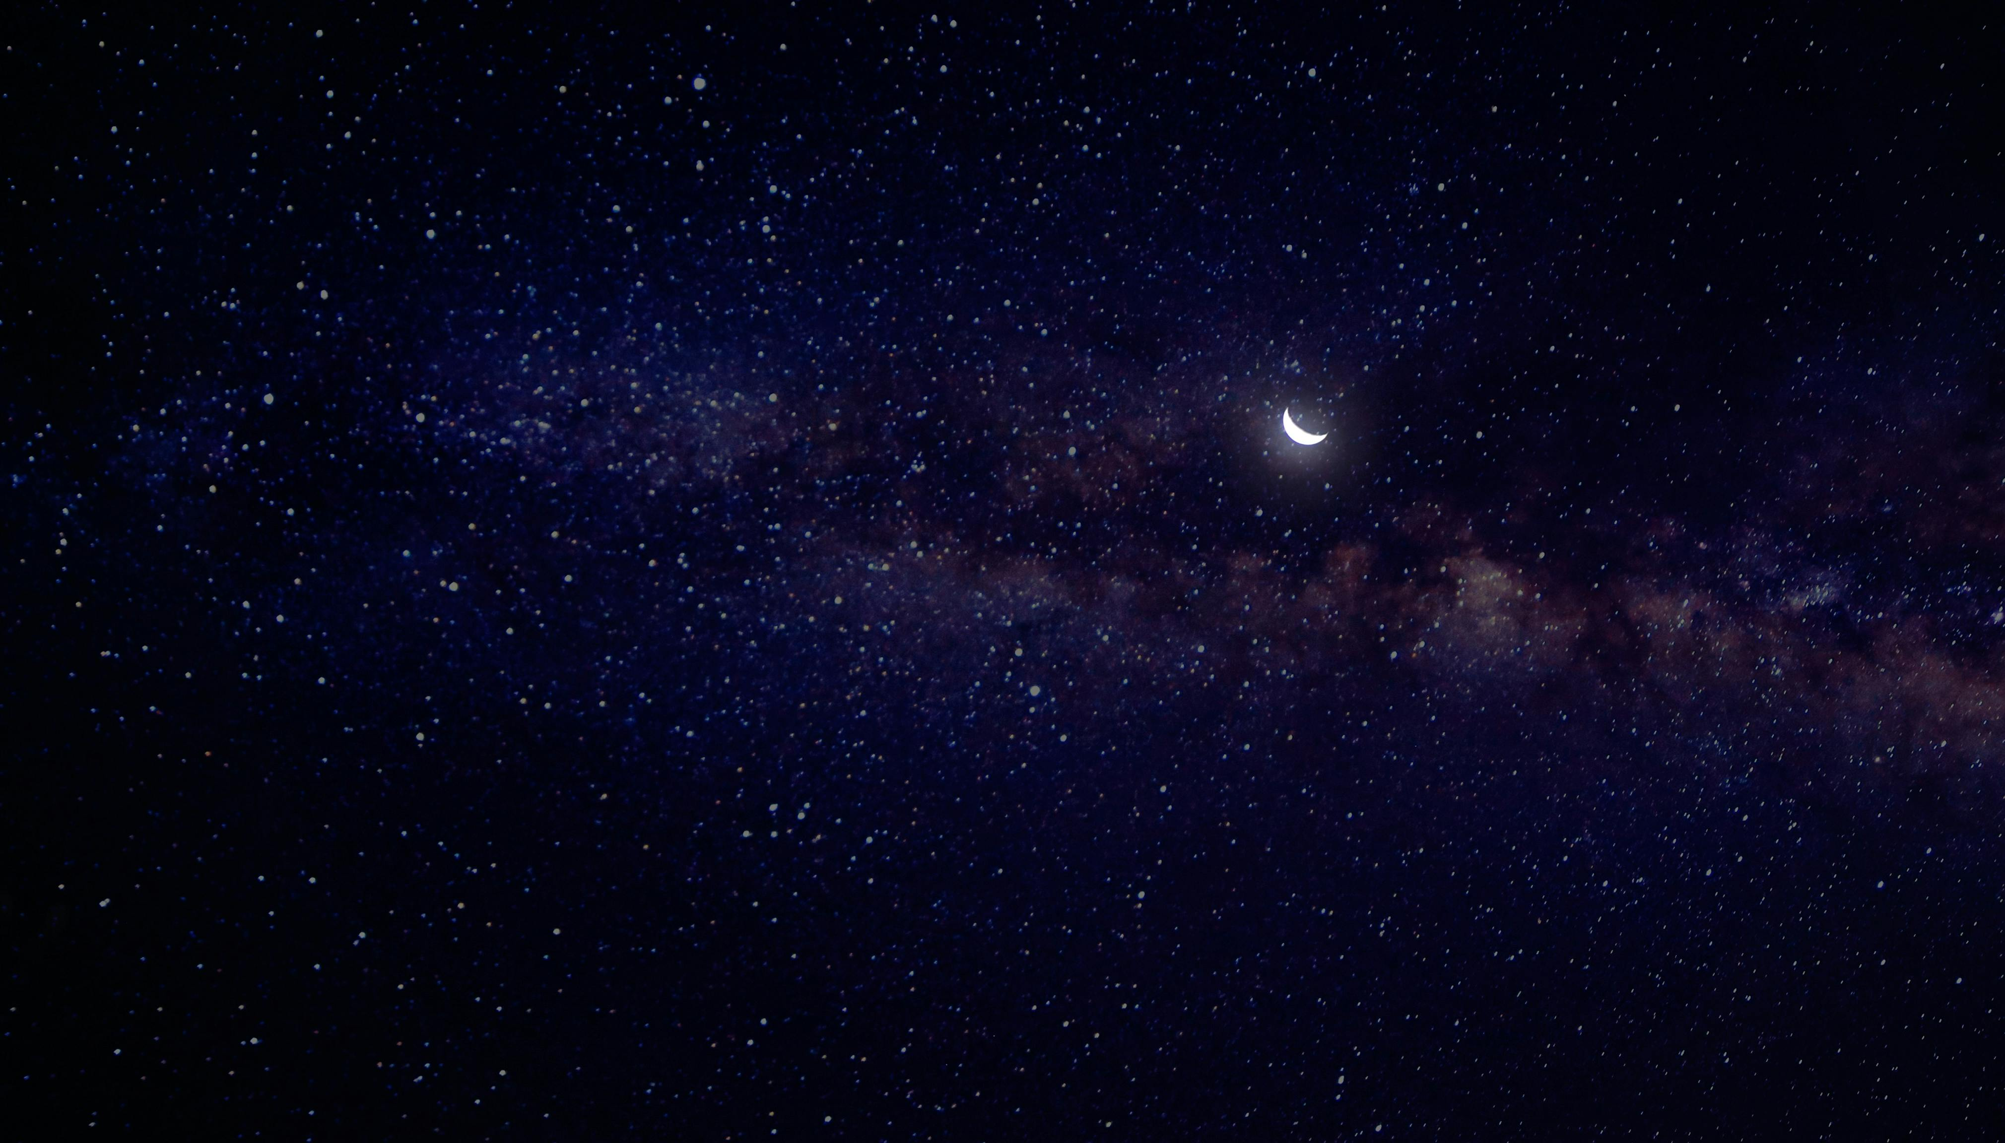
Gravitational Lens Modelling of an IllustrisTNG Mock Multiply Lensed Supernova
Rommulus Francis Lewis
Final Year Project
Supervisor: Prof Jeremy Lim

Slide 4
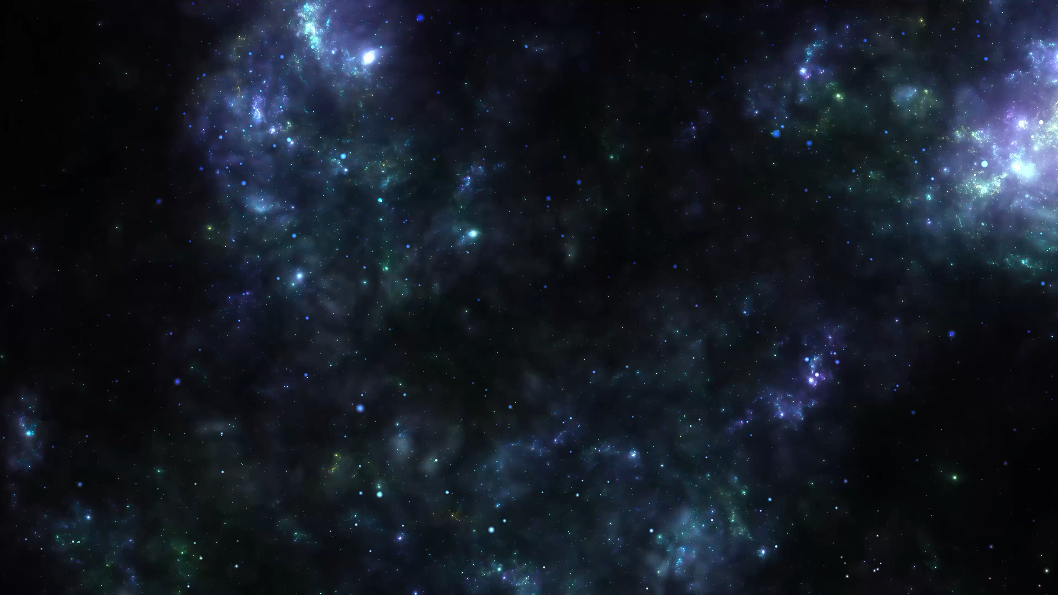
Gravitational Lens Modelling of an IllustrisTNG Mock Multiply Lensed Supernova
Rommulus Francis Lewis
Final Year Project
Supervisor: Prof Jeremy Lim

Slide 5
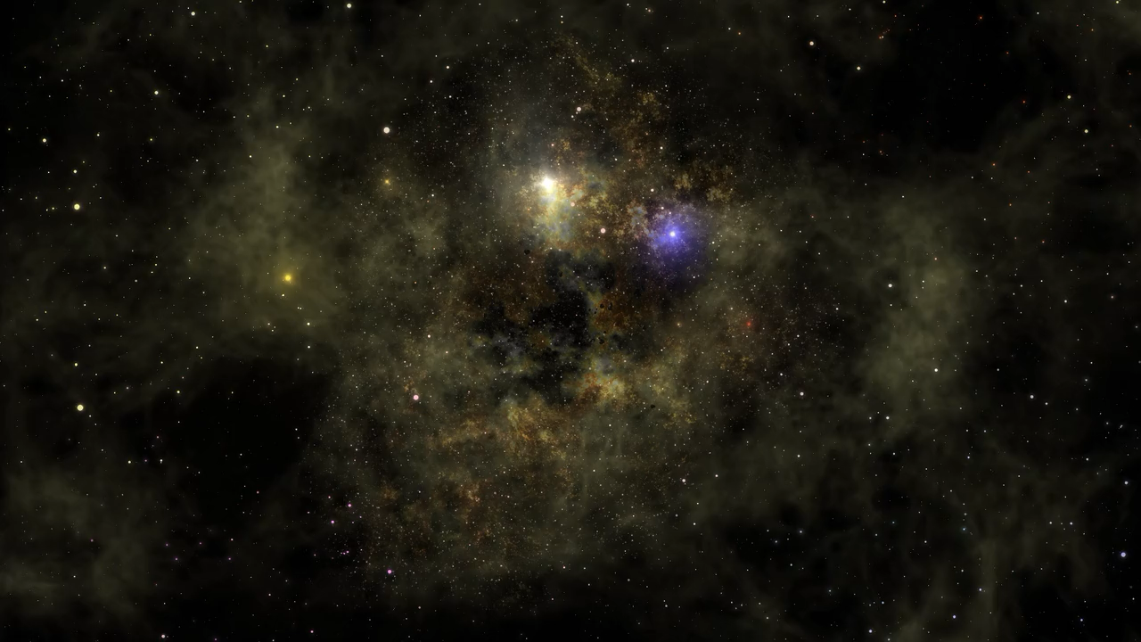
Gravitational Lens Modelling of an IllustrisTNG Mock Multiply Lensed Supernova
Rommulus Francis Lewis
Final Year Project
Supervisor: Prof Jeremy Lim

